Slide 1
DIGITAL ASSIGNMENT 2
Customer Segmentation Using the Online Retail II Dataset
Programming for Data Science (BCSE207L)
Suyash Agrawaal
Reg. No. 24BDS1167
VIT Chennai
Notes:
Introduce yourself and the project. This is the second review: after cleaning the data in DA1, this phase builds customer-level features, a database, and machine learning models.

Slide 2
01 PROJECT OVERVIEW
From shop transactions to customer-level insight
Online Retail II: transactions from a UK online gift retailer, Dec 2009 to Dec 2011
Each row is one product line on an invoice, not a customer
To study customers, rows have to be rolled up into one record per customer
Goals: predict churn, identify high-value customers, and group customers into segments
Store everything in a database that both R and Python can use
1,067,371
raw rows in the dataset
779,425
transactions after cleaning
5,281
customers used for modelling
Customer Segmentation | Online Retail II
2
Notes:
The raw dataset had over a million rows. After the DA1 cleaning steps, 779,425 valid transactions remain. Because churn is defined with a 90-day holdout, only customers active before the cutoff can be modelled, which gives 5,281 customers.

Slide 3
02 WORKFLOW
Project workflow
1
2
3
4
5
6
7
8
Raw Data
Data Cleaning
Feature Engineering
Customer Segmentation
SQLite Database
Machine Learning
Model Optimization
Business Output
Excel, 2 sheets
779,425 rows
RFM + 4 derived
K-Means, k = 4
4 tables, 7 indexes
24 models
Grid search, threshold, SMOTE
Risk bands in SQL
R
R
R
R
R + Python
Python
Python
Python + SQL
R prepares the data and builds the database; Python reads it, trains the models and writes predictions back.
Customer Segmentation | Online Retail II
3
Notes:
Walk through the pipeline left to right. Steps 1 to 4 are done in R. The SQLite file is the link between R and Python. Python does all modelling and then writes predictions back into the same database.

Slide 4
03 FEATURE ENGINEERING
Turning transactions into customer records
Transaction rows
Customer record
R
Recency
How recently the customer purchased (days before cutoff)
F
Frequency
How often the customer buys (distinct invoices)
1 row per customer
group by customer
M
Monetary
How much the customer spends (quantity x price)
Also derived
AvgOrderValue · AvgQuantity · TotalQuantity · OutlierOrders · Country
779,425 rows
5,281 customers
Customer Segmentation | Online Retail II
4
Notes:
Features are computed only from transactions before the cutoff date. RFM is the standard approach from the DA1 literature review. OutlierOrders counts bulk orders that were flagged, not deleted, in DA1. Country was grouped into the top five countries plus Other.

Slide 5
04 PREDICTION TASKS
Three questions, three targets
1
2
3
Churn
High-value customer
Customer segment
No purchase in the 90 days after the cutoff
Top 20% of customers by Monetary value
K-Means clustering on scaled RFM, k = 4
Churned: 2,989
Retained: 2,292
High-value: 1,057
Standard: 4,224
S1: 2,144
S2: 246
S3: 2,876
S4: 15
Close to balanced
About 1 : 4
Highly uneven (S4 = 15)
Customer Segmentation | Online Retail II
5
Notes:
Churn uses a time-based definition, which is the key design choice. High-value is imbalanced by design, which is why SMOTE is used later. Segments come from K-Means with k = 4 and are very uneven: segment 4 has only 15 wholesale customers.

Slide 6
05 A MISTAKE WE FIXED
Data leakage: an important correction
Initial churn label
Churn = Recency > 90 days
What went wrong
The first churn label was built from Recency, and Recency was also given to the model. The model was just reading back the rule, not predicting anything.
100% accuracy
Every model, suspiciously perfect
Leakage identified
How it was fixed
Recency was both the label rule and a feature
Features use only transactions up to 90 days before the end of the data. The label checks whether the customer actually bought again after that. Customers dropped from 5,878 to 5,281.
90-day time-based holdout
Features before cutoff, label after it
Realistic evaluation
Accuracy about 70-74%
Customer Segmentation | Online Retail II
6
Notes:
This is the main learning point of the phase. A perfect score on a real problem is a warning sign. After the fix, accuracy dropped to a realistic 70 to 74 percent, and those numbers can be trusted. The same idea was applied to high-value: Monetary and AvgOrderValue were removed from its features.

Slide 7
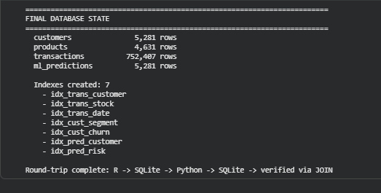
06 DATABASE DESIGN
SQLite database connecting R and Python
R
writes customers, products, transactions
Tables
customers
5,281 rows
products
4,631 rows
SQLite
da2_retail_normalized.sqlite
transactions
752,407 rows
ml_predictions
5,281 rows
Python
reads data, trains models
Final database check from the Colab notebook
Primary keys on every table
Foreign keys to customers and products
CHECK constraints on targets, quantity, price
7 indexes on join and filter columns
SQLite
ml_predictions written back
Customer Segmentation | Online Retail II
7
Notes:
SQLite was chosen because it is a single file with no server, and both R and Python support it natively. The schema was written by hand with keys and constraints, so bad records are rejected. Indexes made the benchmark join query faster. Python later adds the ml_predictions table, which completes the round trip.

Slide 8
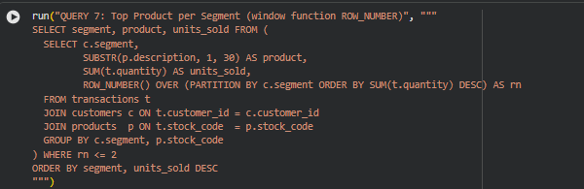
07 SQL ANALYSIS
Nine analytical SQL queries
Queries were run from Python on the normalized database. Together they cover:
JOIN + GROUP BY
revenue per segment
Aggregation
churn rate by country
Subquery
customers above 2x average spend
Query 7: ROW_NUMBER() ranks products separately inside each segment
Window function
top products per segment
Parameterised query
safe input, no SQL injection
Retained customers order about 3x as often and spend about 4x as much as churned customers (Query 9).
CASE expression
churned vs retained
Customer Segmentation | Online Retail II
8
Notes:
Explain one query in detail, the window function. It ranks products within each segment, so one query gives the top two products for all four segments. Query 9 compares churned and retained customers and shows why behaviour features predict churn.

Slide 9
08 MACHINE LEARNING
24 models across three tasks
13
6
5
Plus a stacking ensemble (MLP + Gradient Boosting + Random Forest)
Churn
High-value
Segment
Churn models grouped by family
Linear / Kernel
Instance-based / Probabilistic
Tree
Ensemble / Boosting
Deep learning
Logistic Regression
Linear Discriminant Analysis
Support Vector Machine
K-Nearest Neighbors
Gaussian Naive Bayes
Decision Tree
Random Forest
Extra Trees
AdaBoost
Gradient Boosting
XGBoost
LightGBM
Neural Network (MLP)
Customer Segmentation | Online Retail II
9
Notes:
Thirteen algorithms were chosen from different families so the comparison is fair. All use the same stratified 75/25 split, with the scaler fitted only on training data. High-value models do not see Monetary or AvgOrderValue, to avoid leakage.

Slide 10
09 RESULTS
Churn Prediction: Model Comparison
Top models are very close
Ten of 13 models are within about 4 points of each other, so the features set the limit more than the algorithm.
Small gain from stacking
0.809 vs 0.807 for the MLP alone.
MLP vs Gradient Boosting
McNemar's test: p = 0.040, significant at 5% but not by a wide margin.
Customer Segmentation | Online Retail II
10
Notes:
ROC-AUC is used because it does not depend on the threshold. Mention that Naive Bayes has the highest recall, 0.957, but the lowest accuracy, 0.640, because it flags almost everyone. Five-fold cross-validation gave the same ranking with standard deviations below 0.011.

Slide 11
10 MODEL OPTIMIZATION
Three ways the models were improved
1
2
3
Grid search + cross-validation
Decision threshold
SMOTE
Gradient Boosting, ROC-AUC
Gradient Boosting churn recall
High-value recall, Logistic Regression
Before
0.805
0.500
0.809
Before
0.814
Tuned
0.807
0.453
0.873
After
0.958
3-fold CV on training data. Logistic Regression showed no real gain.
Catching more churners matters more than a few extra false alarms.
Applied to training data only; the test set keeps the real class ratio.
Bars are drawn on a 0 to 1 scale.
Customer Segmentation | Online Retail II
11
Notes:
Grid search helped Gradient Boosting only slightly, 0.805 to 0.807. Moving the threshold from 0.5 to 0.453 gave the biggest practical gain: recall 0.809 to 0.873, and F1 also rose from 0.771 to 0.791. SMOTE raised minority-class recall for Logistic Regression from 0.814 to 0.958; for Random Forest, F1 fell slightly because precision dropped.

Slide 12
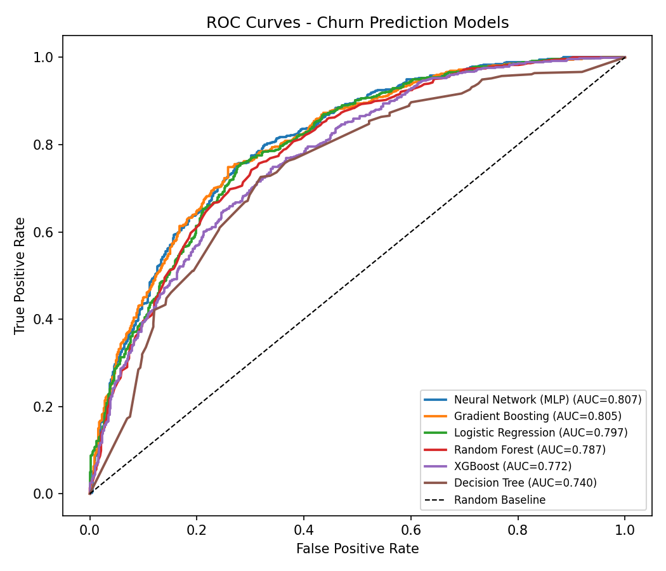
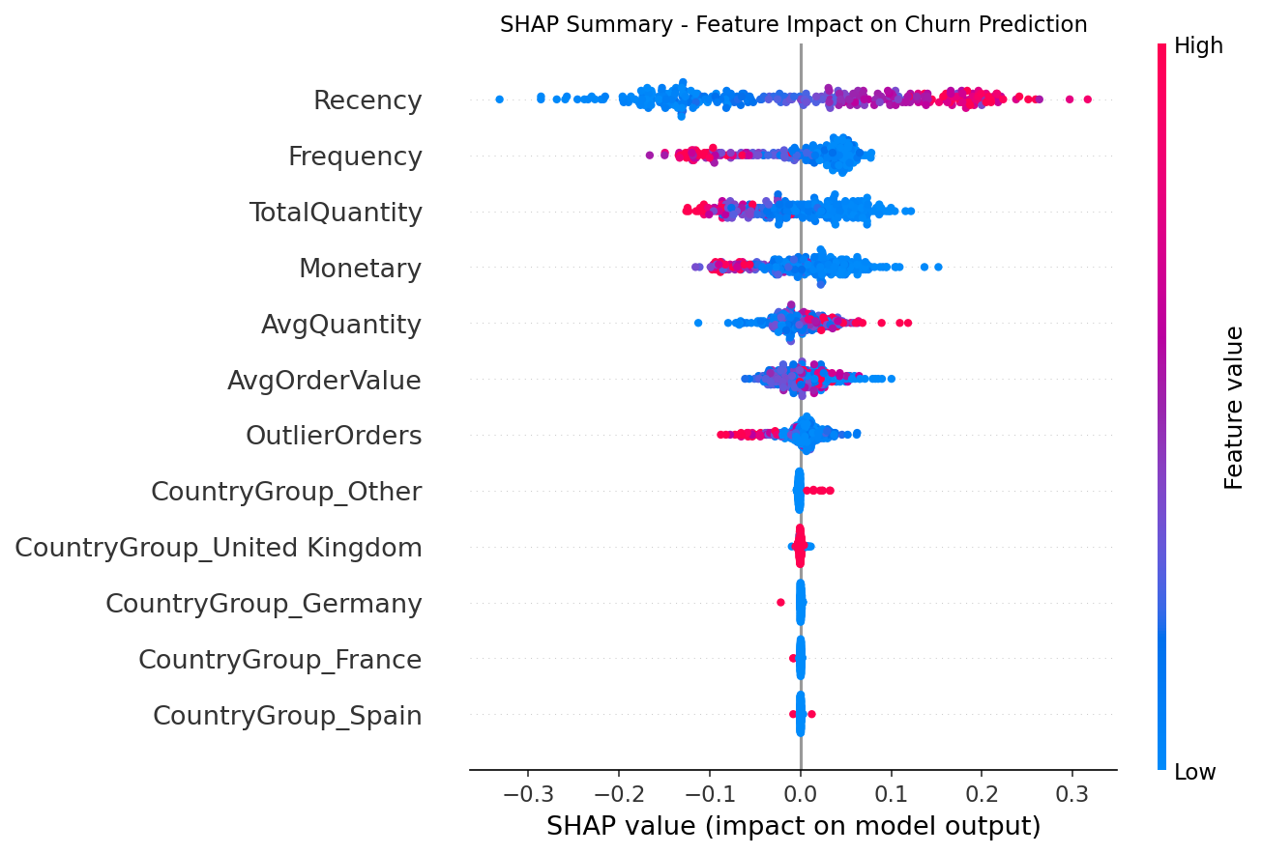
11 EVALUATION AND EXPLAINABILITY
Looking beyond accuracy
Every model was checked with:
ROC curves
Precision-recall curves
Confusion matrices
Feature importance
SHAP values
Learning curves
Calibration plots
Recency is the strongest feature. Random Forest overfits: training score 1.0, validation about 0.77.
ROC curves for six churn models
SHAP summary: each point is one customer
Customer Segmentation | Online Retail II
12
Notes:
Accuracy alone hides the type of errors. ROC and precision-recall curves show the trade-offs; confusion matrices split the errors. SHAP shows direction: high Recency pushes towards churn. Learning curves showed Random Forest memorises the training data, while Gradient Boosting generalises better.

Slide 13
12 BUSINESS OUTPUT
From predictions to action
Customer data
Prediction
Churn probability
Risk band
SQL analysis
Business action
Low risk
Medium risk
High risk
Important
probability < 0.3
0.3 to 0.6
above 0.6
GBP 2.02 million is what high-risk customers have spent in the past. It is historical revenue, not a forecast of future revenue.
989 customers
avg churn probability 0.154
GBP 9.37 million historical spend
1,677 customers
avg churn probability 0.465
GBP 2.54 million historical spend
2,615 customers
avg churn probability 0.787
GBP 2.02 million historical spend
Example: customer 12346 spent GBP 77,556 and has a churn risk of 0.902.
A second query lists high-value customers inside the high-risk band, giving a direct retention list.
Customer Segmentation | Online Retail II
13
Notes:
Python wrote each customer's churn probability back to SQLite as ml_predictions. A join with the customers table, written by R, gives the risk band summary. Stress that the 2.02 million is past spend of high-risk customers, not predicted loss. Lifetime value rises as risk falls, so the model ranking lines up with business value.

Slide 14
13 FINDINGS AND LIMITATIONS
What we learned
Key findings
Limitations
RFM features give strong signals about customer behaviour
A time-based churn label avoids leakage and gives honest scores
SQLite connects R and Python in one pipeline
24 models compared across three tasks
Threshold tuning and SMOTE improved recall where it mattered
Predictions are stored back in the database for SQL analysis
Segments are very uneven: segment 4 has only 15 customers, so macro recall is lower
Segment classification mostly rebuilds the K-Means boundary, so its near-perfect score is expected
Churn ROC-AUC levels off around 0.80; the features set the limit
Tuning was only done for churn; high-value and segment models use defaults
Some calibration curves drift from the diagonal
Customer Segmentation | Online Retail II
14
Notes:
Keep limitations honest and tie each one to evidence in the report. Tuning the other two tasks and calibration are part of the remaining work for the final review.

Slide 15
CONCLUSION
The project combines customer-level feature engineering, a shared SQLite database and machine learning to turn retail transactions into customer insights a business can act on.
Thank you
Questions?
Suyash Agrawaal · 24BDS1167
Notes:
Summarise in one line: clean data, customer features, a database used by both R and Python, compared models, and a usable retention list. Remaining work for DA3 is the dashboard, tuning the other tasks and the final write-up.

